Slide 1
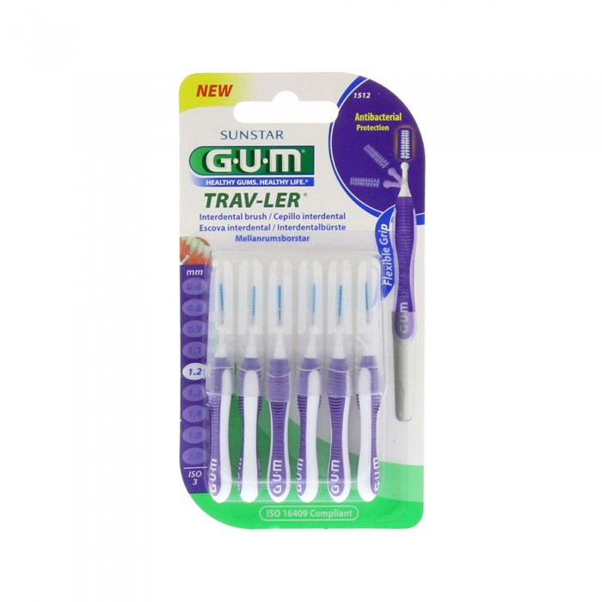
JOM
Jum Travler Brush Between Teeth 1.2 mm 1512 - 6 Beads
6 pills
29.00 SAR. Q
Features
An ideal brush for individuals with sensitive teeth and suitable for weak and sensitive gums. To clean between the teeth of the calendar holders, which keeps the teeth white and makes them without bad smell

Slide 2
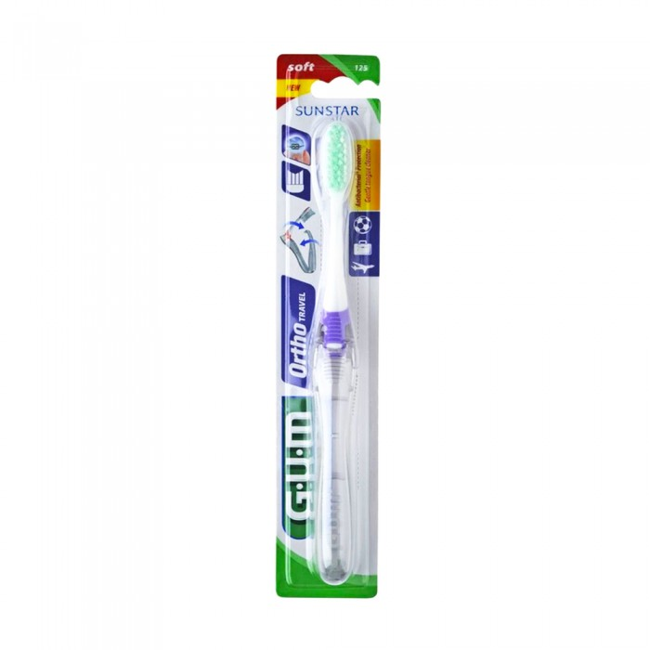
JOM
Jum Toothbrush Calendar For Travel 125 Soft
1 pill
23.00 SAR. Q

Slide 3
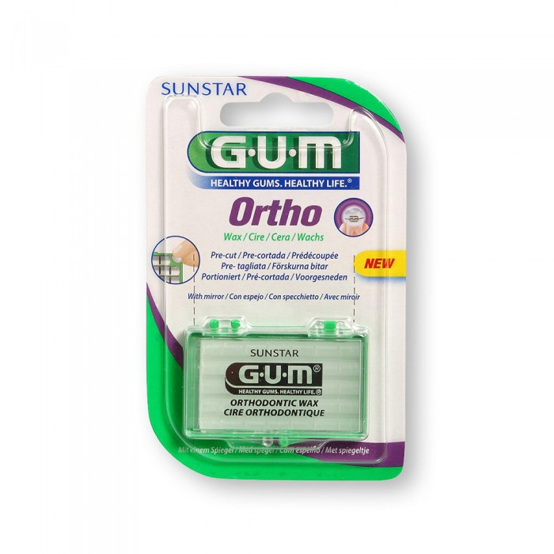
JOM
JUM Teeth Wax 723
1 pill
29.00 SAR. Q

Slide 4
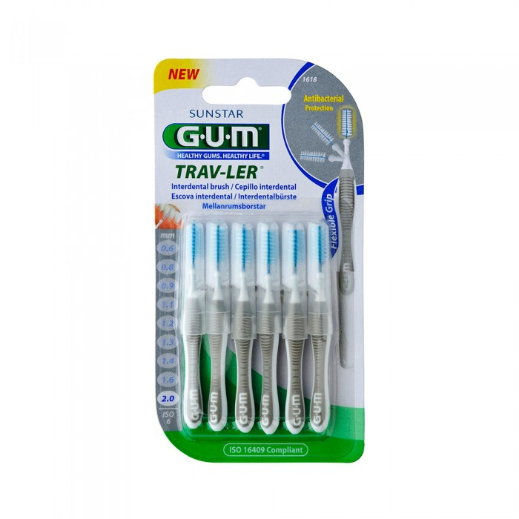
JOM
Gum Brush Between Teeth 1618 0.2mm 6 Beads
6 pills
29.00 SAR. Q
Features
Brush used for interdental cleaning for calendar users which keeps the teeth white and mouth smell nice
An ideal brush for individuals with sensitive teeth and suitable for weak and sensitive gums.

